Slide 1
Digital Portfolio
STUDENT NAME: MOHAMMED SADIQ.A
REGISTER NO AND NMID: 222401222 & asunm11024ai112
DEPARTMENT: B.Sc.Computer Science With Artificial Intelligence.
COLLEGE: DRBCCC HINDU COLLEGE, MADRAS UNIVERSITY.

Slide 2
PROJECT TITLE
DIGITAL PORTFOLIO

Slide 3


AGENDA
Problem Statement
Project Overview
End Users
Tools and Technologies
Portfolio design and Layout
Features and Functionality
Results and Screenshots
Conclusion
Github Link
3/21/2024 Annual Review

Slide 4

PROBLEM STATEMENT
Students and developers often lack a structured and visually appealing way to present their skills, projects, and achievements online. Traditional resumes fail to showcase creativity, interactivity, and real project work. Hence, a personal portfolio website is needed to highlight capabilities in a professional and modern way.

Slide 5

PROJECT OVERVIEW
This project is a Personal Portfolio Website for Mohammed Sadiq.A, designed using HTML, CSS, and JavaScript. It features multiple sections such as About, Skills, Projects, and Contact, along with smooth animations and a responsive layout. The portfolio allows recruiters, collaborators, and clients to understand the developer’s skillset and explore their work easily.

Slide 6

WHO ARE THE END USERS?
Recruiters/Employers – To evaluate skills and projects.
Clients – To find potential freelancers for web/AI projects.
Peers/Collaborators – To connect for open-source or academic work.
Academic Evaluation – Can be used as a project submission in college.

Slide 7

TOOLS AND TECHNIQUES
Languages: HTML5, CSS3, JavaScript
Icons & UI Enhancements: Font Awesome
Styling: CSS Animations, Flexbox, Grid, Media Queries (Responsive Design)
Version Control: GitHub
Deployment (optional): GitHub Pages / Netlify

Slide 8
PORTFOLIO DESIGN AND LAYOUT
Header & Navbar: Sticky header with navigation links (About, Skills, Projects, Contact).
Hero Section: Name, role, and CTA buttons ("View My Work", "Contact Me").
About Section: Profile image + personal details + background.
Skills Section: Cards with icons and descriptions of skills (Python, Java, Full Stack, AI, Data Analytics, Digital Marketing).
Projects Section: Cards with icons, titles, and descriptions of sample projects (AI Chatbot, E-Commerce, Data Visualization).
Contact Section: Email link + social icons (LinkedIn, GitHub, Twitter, Instagram).
Footer: Copyright notice.
8

Slide 9
FEATURES AND FUNCTIONALITY
Responsive design (mobile-friendly).
Smooth scrolling navigation.
Hero section with animated intro text.
Skills and project cards with hover animations.
Intersection Observer (JavaScript) for fade-in animations when elements come into view.
Contact section with direct email and social links.

Slide 10
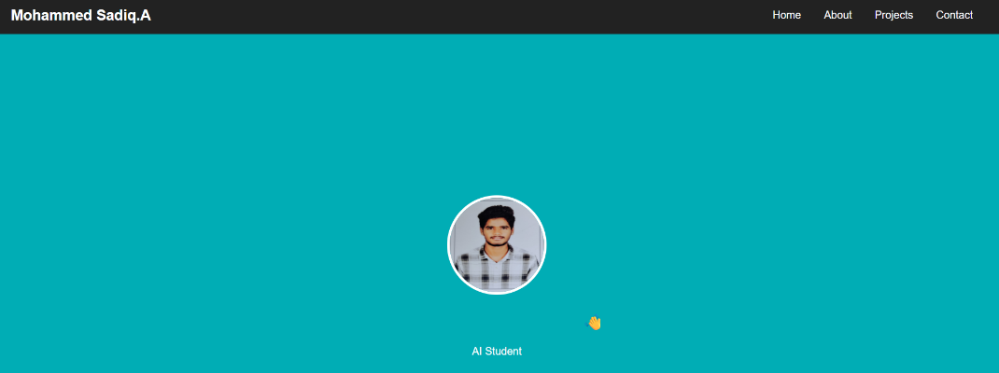
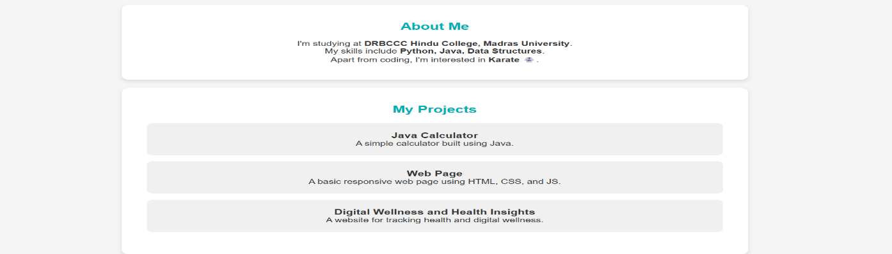
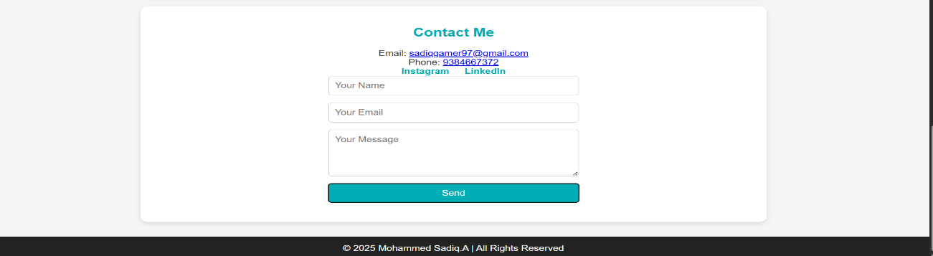
RESULTS AND SCREENSHOTS
3/21/2024 Annual Review
10

Slide 11
CONCLUSION
The portfolio project demonstrates web development, UI/UX design, and branding skills. It is responsive, interactive, and professional, making it a valuable tool for job applications, freelancing, and academic submissions. Future enhancements can include a contact form, dark mode, and hosting live demos of projects.
11

Slide 12
GITHUB LINK

